Slide 1
Component Design

Slide 2
What are Componets

Slide 3
Modular decomposition styles
Styles of decomposing sub-systems into modules.
No rigid distinction between system organisation and modular decomposition.

Slide 4
Sub-systems and modules
A sub-system is a system in its own right whose operation is independent of the services provided by other sub-systems.
A module is a system component that provides services to other components but would not normally be considered as a separate system.

Slide 5
Modular decomposition
Another structural level where sub-systems are decomposed into modules.
Two modular decomposition models covered
  An object model where the system is decomposed into interacting object;
  A pipeline or data-flow model where the system is decomposed into functional modules which transform inputs to outputs.
If possible, decisions about concurrency should be delayed until modules are implemented.

Slide 6
Object models
Structure the system into a set of loosely coupled objects with well-defined interfaces.
Object-oriented decomposition is concerned with identifying object classes, their attributes and operations.
When implemented, objects are created from these classes and some control model used to coordinate object operations.

Slide 7
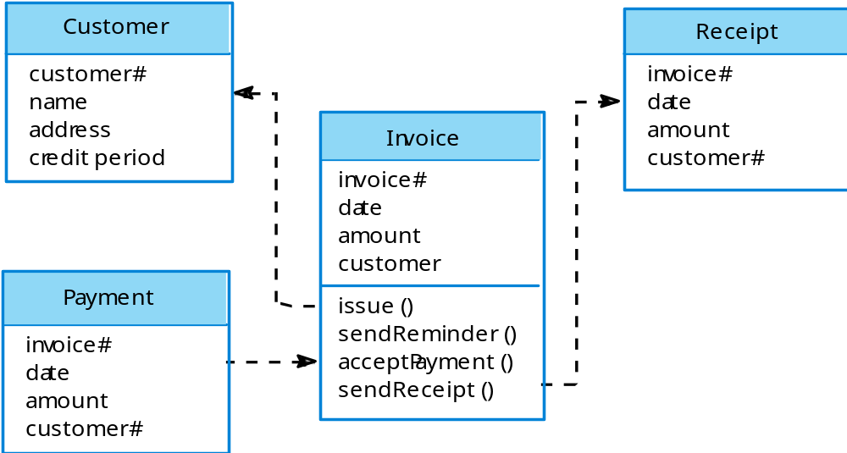
Invoice processing system

Slide 8
Object model advantages
Objects are loosely coupled so their implementation can be modified without affecting other objects.
The objects may reflect real-world entities.
OO implementation languages are widely used.
However, object interface changes may cause problems and complex entities may be hard to represent as objects.

Slide 9
Function-oriented pipelining
Functional transformations process their inputs to produce outputs.
May be referred to as a pipe and filter model (as in UNIX shell).
Variants of this approach are very common. When transformations are sequential, this is a batch sequential model which is extensively used in data processing systems.
Not really suitable for interactive systems.

Slide 10
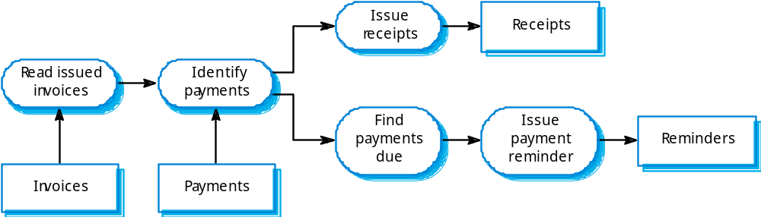
Invoice processing system

Slide 11
Pipeline model advantages
Supports transformation reuse.
Intuitive organisation for stakeholder communication.
Easy to add new transformations.
Relatively simple to implement as either a concurrent or sequential system.
However, requires a common format for data transfer along the pipeline and difficult to support event-based interaction.

Slide 12
Control styles
Are concerned with the control flow between sub-systems. Distinct from the system decomposition model.
Centralised control
  One sub-system has overall responsibility for control and starts and stops other sub-systems.
Event-based control
  Each sub-system can respond to externally generated events from other sub-systems or the system’s environment.

Slide 13
Centralised control
A control sub-system takes responsibility for managing the execution of other sub-systems.
Call-return model
  Top-down subroutine model where control starts at the top of a subroutine hierarchy and moves downwards. Applicable to sequential systems.
Manager model
  Applicable to concurrent systems. One system component controls the stopping, starting and coordination of other system processes. Can be implemented in sequential systems as a case statement.

Slide 14
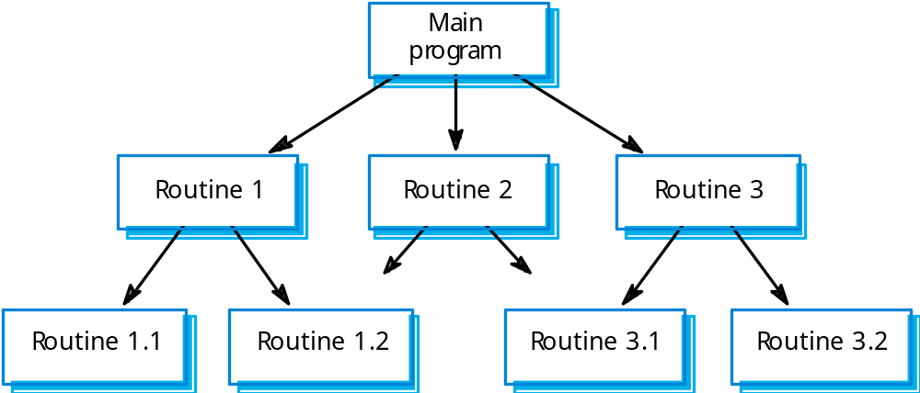
Call-return model

Slide 15
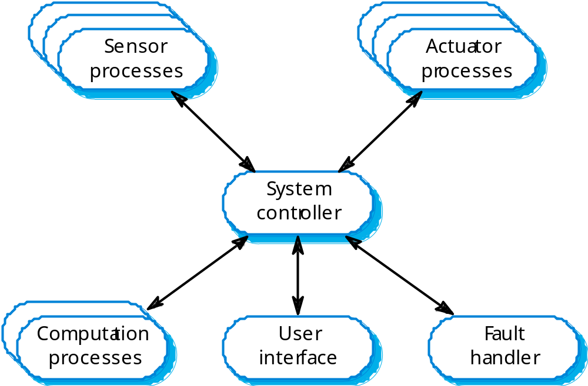
Real-time system control

Slide 16
Event-driven systems
Driven by externally generated events where the timing of the event is outwith the control of the sub-systems which process the event.
Two principal event-driven models
  Broadcast models. An event is broadcast to all sub-systems. Any sub-system which can handle the event may do so;
  Interrupt-driven models. Used in real-time systems where interrupts are detected by an interrupt handler and passed to some other component for processing.
Other event driven models include spreadsheets and production systems.

Slide 17
Broadcast model
Effective in integrating sub-systems on different computers in a network.
Sub-systems register an interest in specific events. When these occur, control is transferred to the sub-system which can handle the event.
Control policy is not embedded in the event and message handler. Sub-systems decide on events of interest to them.
However, sub-systems don’t know if or when an event will be handled.

Slide 18
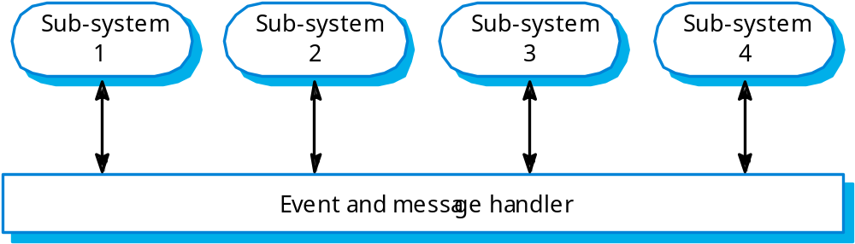
Selective broadcasting

Slide 19
Interrupt-driven systems
Used in real-time systems where fast response to an event is essential.
There are known interrupt types with a handler defined for each type.
Each type is associated with a memory location and a hardware switch causes transfer to its handler.
Allows fast response but complex to program and difficult to validate.

Slide 20
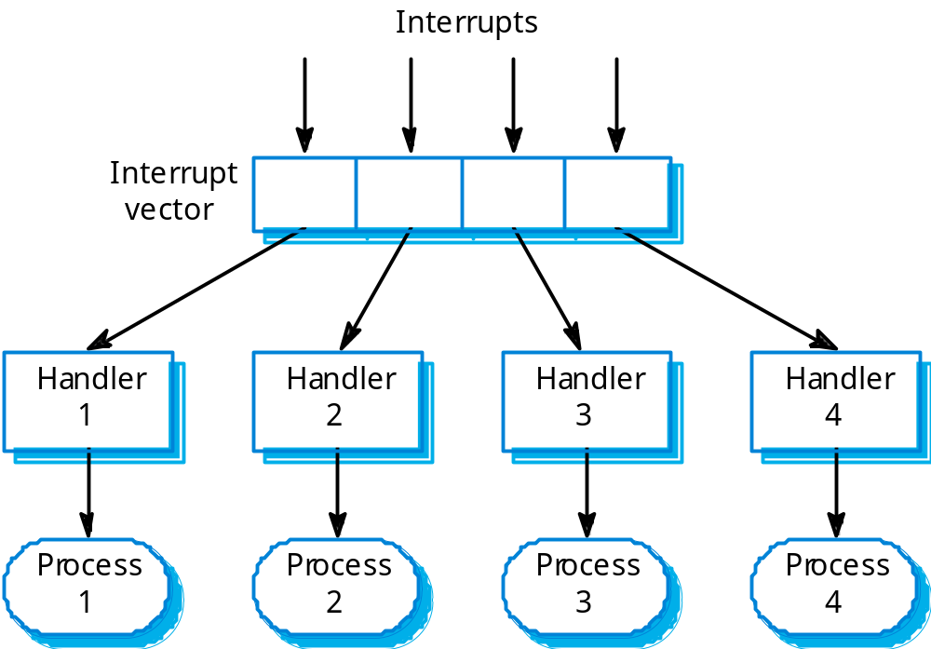
Interrupt-driven control

Slide 21
Reference architectures
Architectural models may be specific to some application domain.
Two types of domain-specific model
  Generic models which are abstractions from a number of real systems and which encapsulate the principal characteristics of these systems. Covered in Chapter 13.
  Reference models which are more abstract, idealised model. Provide a means of information about that class of system and of comparing different architectures.
Generic models are usually bottom-up models; Reference models are top-down models.

Slide 22
Reference architectures
Reference models are derived from a study of the application domain rather than from existing systems.
May be used as a basis for system implementation or to compare different systems. It acts as a standard against which systems can be evaluated.
OSI model is a layered model for communication systems.

Slide 23
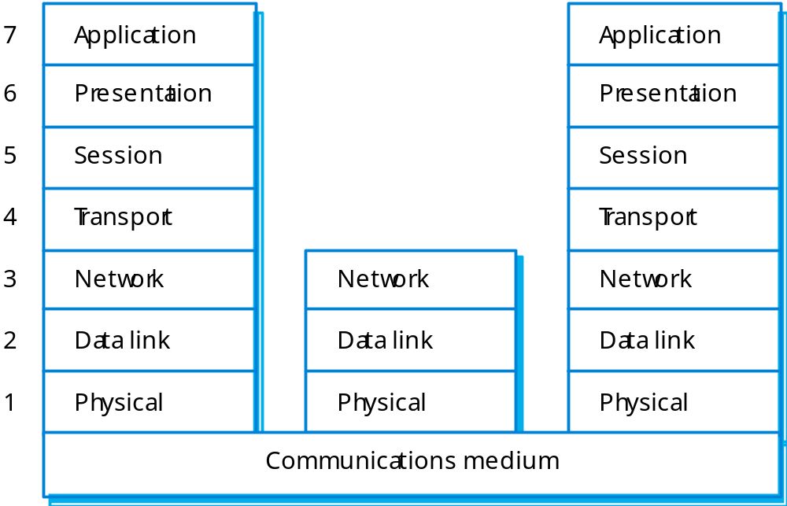
OSI reference model

Slide 24
Case reference model
Data repository services
  Storage and management of data items.
Data integration services
  Managing groups of entities.
Task management services
  Definition and enaction of process models.
Messaging services
  Tool-tool and tool-environment communication.
User interface services
  User interface development.

Slide 25
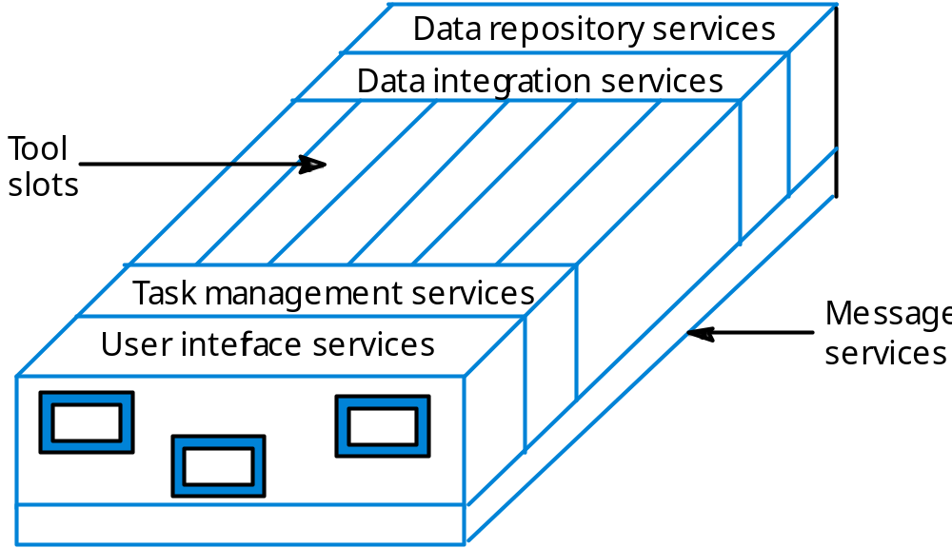
The ECMA reference model

Slide 26
Key points
The software architecture is the fundamental framework for structuring the system.
Architectural design decisions include decisions on the application architecture, the distribution and the architectural styles to be used.
Different architectural models such as a structural model, a control model and a decomposition model may be developed.
System architecture models include mainframe models, client-server models, multi-layer models and service-oriented architecture (SOA) models.

Slide 27
Key points
Modular decomposition models include object models and pipelining models.
Control models include centralised control and event-driven models.
Reference architectures may be used to communicate domain-specific architectures and to assess and compare architectural designs.

Slide 28
Architectural models
Different architectural models may be produced during the design process
Each model presents different perspectives on the architecture

Slide 29
Architecture attributes
Performance
  Localise operations to minimise sub-system communication
Security
  Use a layered architecture with critical assets in inner layers
Safety
  Isolate safety-critical components
Availability
  Include redundant components in the architecture
Maintainability
  Use fine-grain, self-contained components

